Slide 1
Planning For the IRRC CIG Proposal

Slide 2
News from OME
There will be a CIG competition this spring (no guess on when the Notice Inviting Applicants [NIA] will come out)
CIGs will need to focus on evidence-based interventions
CIGs will have to address the Secretary’s priorities (not sure if all or a select few)
CIGs can address more than one of the 8 MEP Absolute Priorities (not sure if all 8 will be included in the NIA)

Slide 3
8 MEP Absolute Priorities
1. ID&R
2. School Readiness
3. Reading Proficiency
4. Mathematics Proficiency
5. Decreased dropouts/improved HS completion
6. Parent involvement
7. Innovative educational technologies
8. OSY

Slide 4
Secretary’s 11 Priorities
Most likely, the CIG NIA will include 2-3 of the Secretary’s Priorities that will have to be addressed by the CIGs.
See Handout showing the Secretary’s Priorities and Priority Areas – yellow highlighted priorities areas are those that IRRC could potentially address if the Priority is selected for the NIA.

Slide 5
What is Needed for the CIG Proposal from IRRC States? (as required in previous competitions)
Letter of Commitment from each participating State signed by the Chief State School Officer, or his/her designee
General Education Provisions Act (GEPA) statement from each State (statement of equitable access)
Assurances and Certifications signed by the Chief State School Officer, or his/her designee
Needs Assessment Data

Slide 6
State Director Proposal Needs Assessment Survey
Each of you received a paper copy of the State Director Proposal Needs Assessment Survey (containing the QR code to the online survey)
This survey will help inform the needs assessment section of the proposal.
Please note that you will need to gather data before responding to the survey including:
-number of statewide, regional, & local recruiters in your State
-number of staff that oversee ID&R statewide
-number of eligible migratory children in your State (birth to 21) during the 2016-17, 2017-18, and 2018-19 performance periods
-whether or not your State hires contractors to assist with ID&R
-whether or not your State hires temporary recruiters

Slide 7
IDRC
Identification and Recruitment Consortium
Year 1: 2020-2021
Year 2: 2021-2022
Year 3: 2022-2023

Slide 8
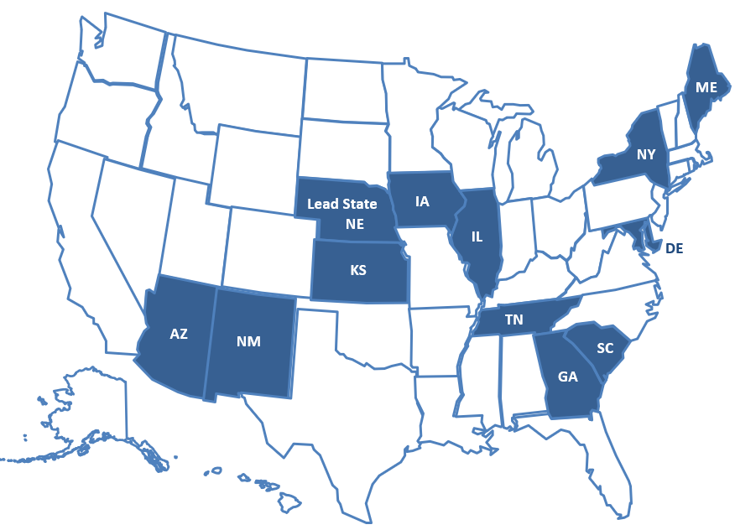
Current IRRC States

Slide 9
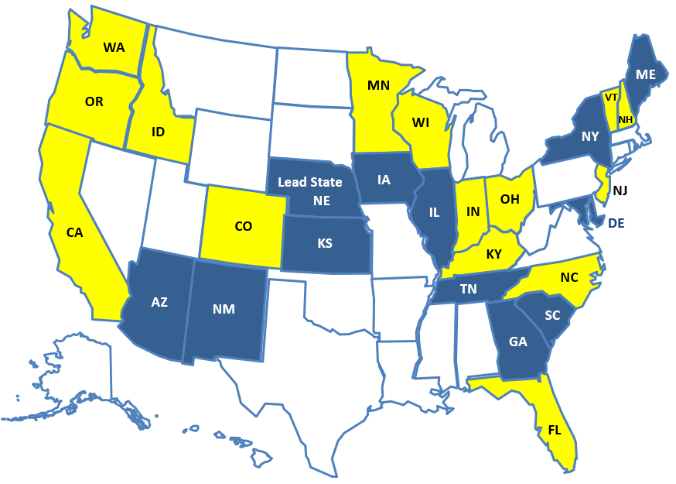
Potential IDRC States
Any others?

Slide 10
Key Component of IDRC: Technology
A tool to identify farms, processing plants, etc. within a state.
Online training module for States, recruiters, school staff, etc. to learn basic information about the MEP and ID&R.
Data reconciliation tools to help states develop a process to help with data reconciliation to improve MSIX data quality leading to quality data that can inform/drive ID&R.
5 minute how to videos about IDRC website navigation/content.

Slide 11
Key Component of IDRC: TRI (Onsite Services) and Capacity Building
Continue TRI visits to IDRC States to: assist states with re-interviewing, provide ID&R sweeps, review current recruitment regions/assess ID&R systems, provide recruiter training/mentoring, assist with establishing/ building relationships with agribusiness, and assist with IR&R efforts in the state, as needed.
Training modules on the differences between MEP child eligibility and HEP/CAMP eligibility and Head Start eligibility.
Training module on using MEP data to inform/drive ID&R.
Training module on data reconciliation to improve MSIX data quality.
Mentoring program on ID&R for new state directors.
Update the Recruiter Assessment.
Recruiter Toolkit for serving migratory students and families during recruitment.

Slide 12
Key Component of IDRC: Coordination
Coordination Workgroup to establish procedures/ suggestions to optimize current relationships and build new relationships with agribusinesses in IDRC States and identification of subject matter experts in various qualifying work.
A categorized list of agencies/organizations with whom States can collaborate for ID&R.
A list of staff with specialized skills that can assist with data-driven ID&R.
Materials that states can use when hiring recruiters (e.g., job descriptions, effective hiring practices, creating a health cultural environment, questions to ask in the hiring process, interview techniques/ strategies).

Slide 13
IDRC State Responsibilities
Coordinate
Coordinate with other IDRC CIG States and maintain ongoing communication
Participate
Participate in 2 SST meetings/year
Provide
Provide a representative to participate on the TST (4 meetings/year face-to-face and virtual)
Implement
Implement IDRC activities
Collect Data
Collect/report data for the evaluation

